Slide 1


Patient Re-admission and Diabetic Medication Prediction
GROUP NO 297
Prashant Raina-A20444481
Vaidehi Rathkanthiwar-A20450703
Utkarsha Vidhale-A20448993
ITMD 525
TOPICS IN DATA MANAGEMENT : DATA MINING

Slide 2

CONTENTS
Introduction
Dataset
KDD
Treating Imbalance Data
Data splitting
Classification Tasks
Best Working Algorithms

Slide 3
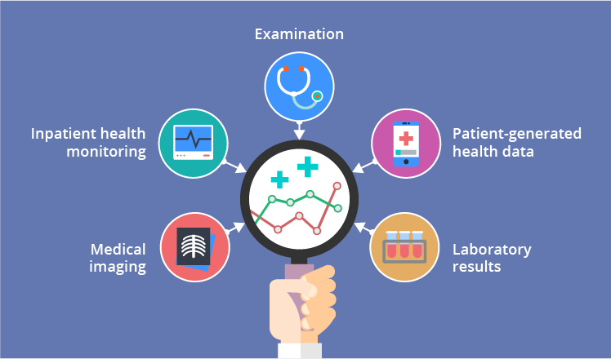
1. INTRODUCTION
Our application will provide general idea of patient’s medical necessity based on diabetic prescription and number of times patient is re-admitted in hospital.
Our model will provide the predictions in terms of whether patient will be prescribed diabetic medication or not.
We will also determine if patient needs to be re-admitted in hospital based on clinical history

Slide 4
2. DATASET
DATASET
GENDER
AGE
SEX
The dataset represents 10 years (1999-2008) of clinical care at 130 US hospitals and integrated delivery networks.
The data contains more than 1,00,000 instances and 50 attributes. The dataset is multivariate in terms of its characteristics, whereas the attributes are numerical and nominal.
TYPE OF MEDICATIONS PROVIDED
NUMBER OF DIAGNOSES
TYPE OF MEDICATIONS
DIAGNOSIS 1
DIADNOSIS 2
DIADNOSIS 3
LAB PROCEDURES
DIABETS MEDICATION
MEDICAL SPECALITY
TIME IN HOSPITAL
CHANGE OF MEDICATIONS
ADMISSION TYPE
RE-ADMITTED
OUT-PATIENTS
IN-PATIENTS
WEIGHT
A1C RESULTS
RACE

Slide 5
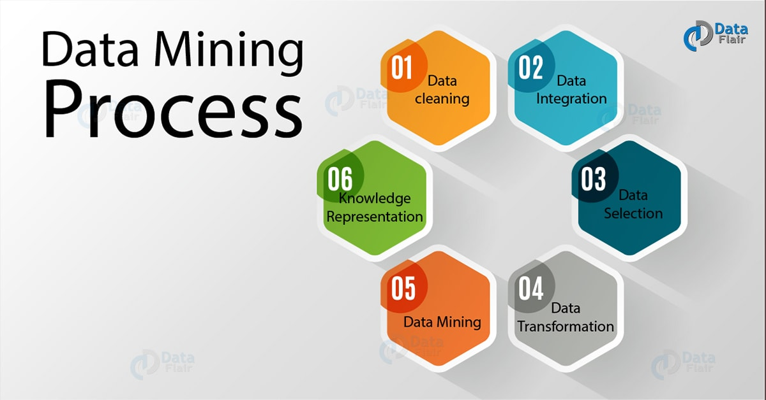
3. KNOWLEDGE DISCOVERY IN DB – DATA PRE PROCESSING
DATA CLEANING
DATA INTEGRATION
DATA TRANSFORMATION
UNIQUE VALUES
Following columns with unique values have been removed.
SINGLE VALUE
Following columns with single values have been removed.
Encounter_id
Patient_nbr
Examide
Citoglipton

Slide 6
3. KNOWLEDGE DISCOVERY IN DB – DATA PRE PROCESSING
DATA CLEANING
DATA INTEGRATION
DATA TRANSFORMATION
MISSING VALUES
Following columns with missing values have been REMOVED.
Weight
- 96.9 %
Medical Specialty
- 49.1%
Payer Code
- 39.6%

Slide 7
3. KNOWLEDGE DISCOVERY IN DB – DATA PRE PROCESSING
DATA CLEANING
DATA INTEGRATION
DATA TRANSFORMATION
MISSING VALUES
Missing values in the following columns have been FILLED with most frequent value of that attribute
Variables
Missing values
Replaced by
 |  | Caucasian
 |  | ”428”
 |  | ”276”
 |  | “259”
Race
2.2 %
Diag_1
0.02%
Diag_2
0.35%
Diag_3
1.39%

Slide 8
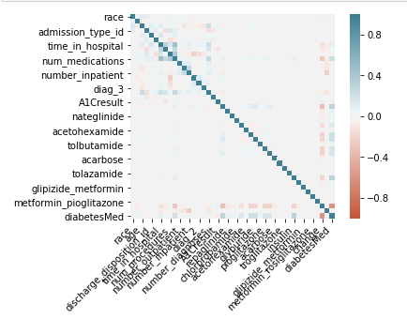
3. KNOWLEDGE DISCOVERY IN DB – DATA PRE PROCESSING
DATA CLEANING
DATA INTEGRATION
DATA TRANSFORMATION
CO RELATION ANALYSIS

Slide 9
3. KNOWLEDGE DISCOVERY IN DB – DATA PRE PROCESSING
DATA CLEANING
DATA INTEGRATION
DATA TRANSFORMATION
GROUPING
The results of diagnosis represented as icd9 codes were grouped in the following columns in 9 groups.
Diag_1
Diag_2
Diag_3

Slide 10
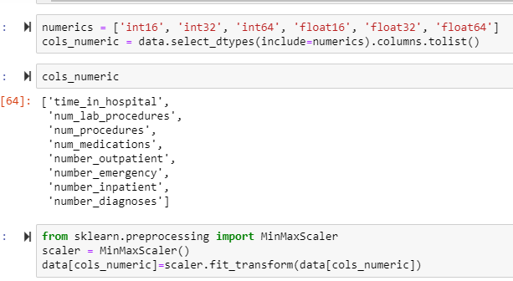
3. KNOWLEDGE DISCOVERY IN DB – DATA PRE PROCESSING
DATA CLEANING
DATA INTEGRATION
DATA TRANSFORMATION
DATA NORMALIZATION
Min Max Normalization to scale all the numeric variables.

Slide 11
3. KNOWLEDGE DISCOVERY IN DB – DATA PRE PROCESSING
DATA CLEANING
DATA INTEGRATION
DATA TRANSFORMATION
DATA DISCRETIZATON
Following data transformation has been performed to get the data in suitable form.
From numeric to nominal data.
From nominal to numeric data using LabelEncoder().
Creation of dummy variables.

Slide 12
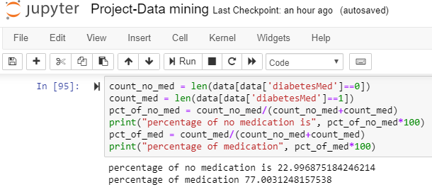
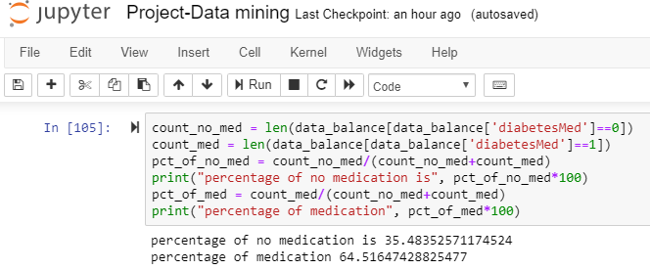
4. TREATING IMBALANCE DATA
Performed oversampling using SMOTE technique to handle imbalanced data. (with respect to Diabetic’s Medication Requirement)
Imbalanced data
Over sampling using SMOTE

Slide 13
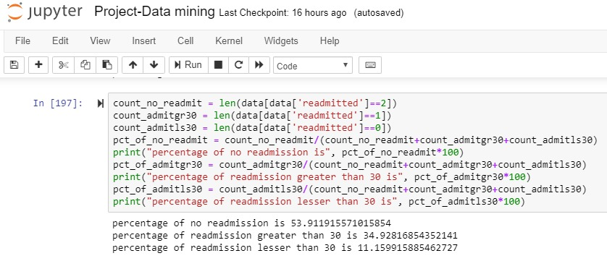
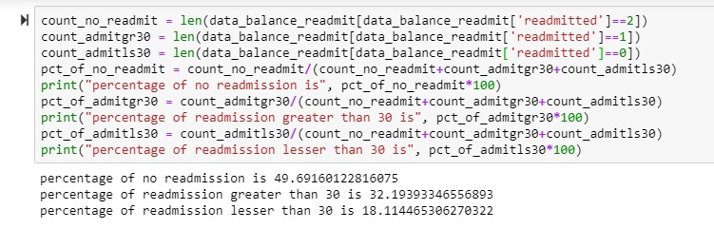
4. TREATING IMBALANCE DATA
Performed oversampling using SMOTE technique to handle imbalanced data. (with respect to Re-admissions)
Imbalanced data
Over sampling using SMOTE

Slide 14
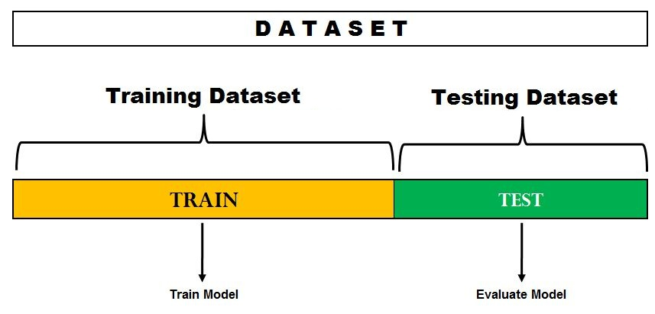
5. DATA SPLITTING
Hold-out Evaluation
We used test size as 20% and training size as 80% to evaluate the different prediction models.

Slide 15
6. CLASSIFICATION TASKS
Naive Bayes
Accuracy – 0.22
PCA
Naïve Bayes
Precision – 0.23
Recall – 0.23
Accuracy – 0.49
Precision – 0.49
Recall – 0.49
Top 20 variables
PREDICTING RE-ADMISSION
NAÏVE BAYES
ACCURACY = 0.49 PRECISON = 0.49 RECALL = 0.49

Slide 16
6. CLASSIFICATION TASKS
PREDICTING RE-ADMISSION
Decision Tree
Decision Tree
Accuracy – 0.50
PCA
Top 20 variables
Decision Tree
Accuracy – 0.48
Precision -0.50
Recall – 0.50
Precision – 0.48
Recall – 0.48
Decision Tree
Accuracy – 0.50
PCA
Top 10 variables
Decision Tree
Accuracy – 0.47
Precision -0.50
Recall – 0.50
Precision – 0.47
Recall – 0.47
ACCURACY = 0.50 PRECISON = 0.50 RECALL = 0.50

Slide 17
6. CLASSIFICATION TASKS
Bagging
Accuracy – 0.57
PCA
Top 20 variables
Bagging
Accuracy – 0.55
Precision – 0.57
Recall – 0.57
Precision – 0.55
Recall – 0.55
PREDICTING RE-ADMISSION
Bagging
ACCURACY = 0.57 PRECISON = 0.57 RECALL = 0.57

Slide 18
6. CLASSIFICATION TASKS
Random Forest
Accuracy – 0.57
PCA
Top 20 variables
Random Forest
Accuracy – 0.55
Precision – 0.57
Recall – 0.57
Precision – 0.55
Recall – 0.55
PREDICTING RE-ADMISSION
Random Forest
ACCURACY = 0.57 PRECISON = 0.57 RECALL = 0.57

Slide 19
6. CLASSIFICATION TASKS
Gradient Boost
PCA
Top 20 variables
Gradient Boost
Accuracy – 0.55
Precision -0.56
Recall – 0.56
Precision – 0.55
Recall – 0.55
Accuracy – 0.56
PREDICTING RE-ADMISSION
Gradient Boost
ACCURACY = 0.56 PRECISON = 0.56 RECALL = 0.56

Slide 20
6. CLASSIFICATION TASKS
SVM
PCA
Top 20 variables
SVM
Accuracy – 0.53
Precision -0.54
Recall – 0.54
Precision – 0.53
Recall – 0.53
Accuracy – 0.54
PREDICTING RE-ADMISSION
SVM
ACCURACY = 0.54 PRECISON = 0.54 RECALL = 0.54

Slide 21
6. CLASSIFICATION TASKS
PREDICTING RE-ADMISSION

Slide 22
6. CLASSIFICATION TASKS
PREDICTING DIABETIC’S MEDICATION REQUIREMENT
Naïve Bayes
Accuracy – 0.99
PCA
Naïve Bayes
Precision – 0.99
Recall - 1
Accuracy – 0.94
Precision- 0.98
Recall – 0.93
Top 20 Variables
NAÏVE BAYES
ACCURACY = 0.94 PRECISON = 0.98 RECALL = 0.93

Slide 23
6. CLASSIFICATION TASKS
Decision Tree
Accuracy – 1
PCA
Top 20 variables
Decision Tree
Accuracy – 0.96
Precision -1
Recall – 1
Precision – 0.96
Recall- 0.96
PREDICTING DIABETIC’S MEDICATION REQUIREMENT
DECISION TREE
ACCURACY = 0.96 PRECISON = 0.96 RECALL = 0.96

Slide 24
6. CLASSIFICATION TASKS
Bagging
Accuracy – 1
PCA
Top 20 variables
Bagging
Accuracy – 0.99
Precision -1
Recall – 1
Precision – 0.95
Recall – 0.97
PREDICTING DIABETIC’S MEDICATION REQUIREMENT
BAGGING
ACCURACY = 0.99 PRECISON = 0.95 RECALL = 0.97

Slide 25
6. CLASSIFICATION TASKS
Random Forest
Accuracy – 1
PCA
Top 20 variables
Random Forest
Accuracy – 0.96
Precision - 1
Recall – 1
Precision – 0.96
Recall – 0.95
PREDICTING DIABETIC’S MEDICATION REQUIREMENT
RANDOM FOREST
ACCURACY = 0.96 PRECISON = 0.96 RECALL = 0.95

Slide 26
6. CLASSIFICATION TASKS
Gradient Boost
PCA
Top 20 variables
Gradient Boost
Accuracy – 0.99
Precision -1
Recall – 1
Precision – 0.95
Recall – 0.97
Accuracy – 1
PREDICTING DIABETIC’S MEDICATION REQUIREMENT
GRADIENT BOOST
ACCURACY = 0.99 PRECISON = 0.95 RECALL = 0.97

Slide 27
6. CLASSIFICATION TASKS
SVM
PCA
Top 20 variables
SVM
Accuracy – 0.98
Precision – 1
Recall – 1
Precision – 0.99
Recall – 0.97
Accuracy – 1
PREDICTING DIABETIC’S MEDICATION REQUIREMENT
SVM
ACCURACY = 0.98 PRECISON = 0.99 RECALL = 0.97

Slide 28
6. CLASSIFICATION TASKS
PREDICTING DIABETIC’S MEDICATION REQUIREMENT

Slide 29
7. BEST WORKING ALGORITHM
Algorithms with highest accuracy :
PREDICTING READMISSION
 | ACCURACY | PRECISION | RECALL
BAGGING | 0.57 | 0.57 | 0.57
RANDOM FOREST | 0.57 | 0.57 | 0.57

Slide 30
7. BEST WORKING ALGORITHM
PREDICTING DIABETIC’S MEDICATION REQUIREMENT
Algorithms with highest accuracy :
 | ACCURACY | PRECISION | RECALL
BAGGING | 0.99 | 0.95 | 0.97
SVM | 0.97 | 0.99 | 0.98

Slide 31
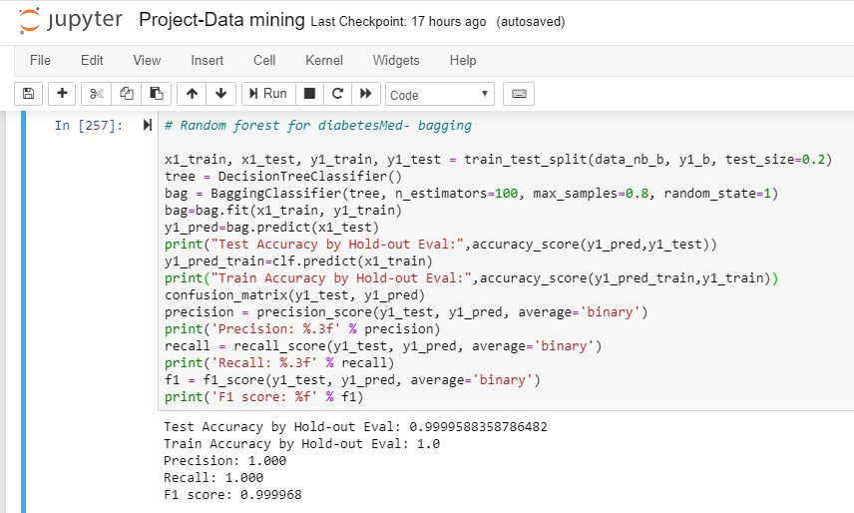
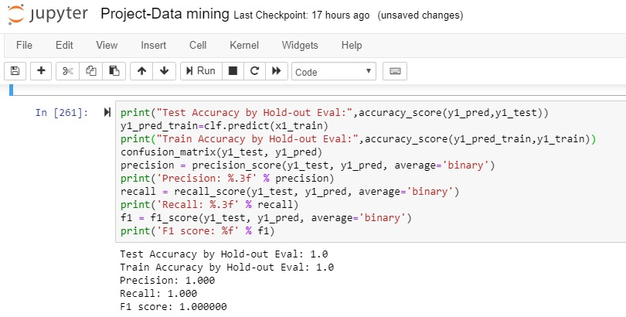
7. BEST WORKING ALGORITHM
PREDICTING DIABETIC’S MEDICATION REQUIREMENT
OVERFITTING CONCERNS : To rule out the possibilities of over fitting, we checked the train accuracy and test accuracy of both the models.
Bagging
Gradient boosting

Slide 32
7. BEST WORKING ALGORITHM
PREDICTING DIABETIC’S MEDICATION REQUIREMENT
OVERFITTING CONCERNS : To rule out the possibilities of over fitting, we checked the train accuracy and test accuracy of both the models.
 | TEST ACCURACY | TRAIN ACCURACY | PRECISION | RECALL | F1 SCORE
BAGGING | 0.99 | 1 | 1 | 1 | 0.99
GRADIENT BOOSTING | 1 | 1 | 1 | 1 | 1
THERE ARE NO OVERFITTING ISSUES.

Slide 33
THANKYOU

